Slide 1
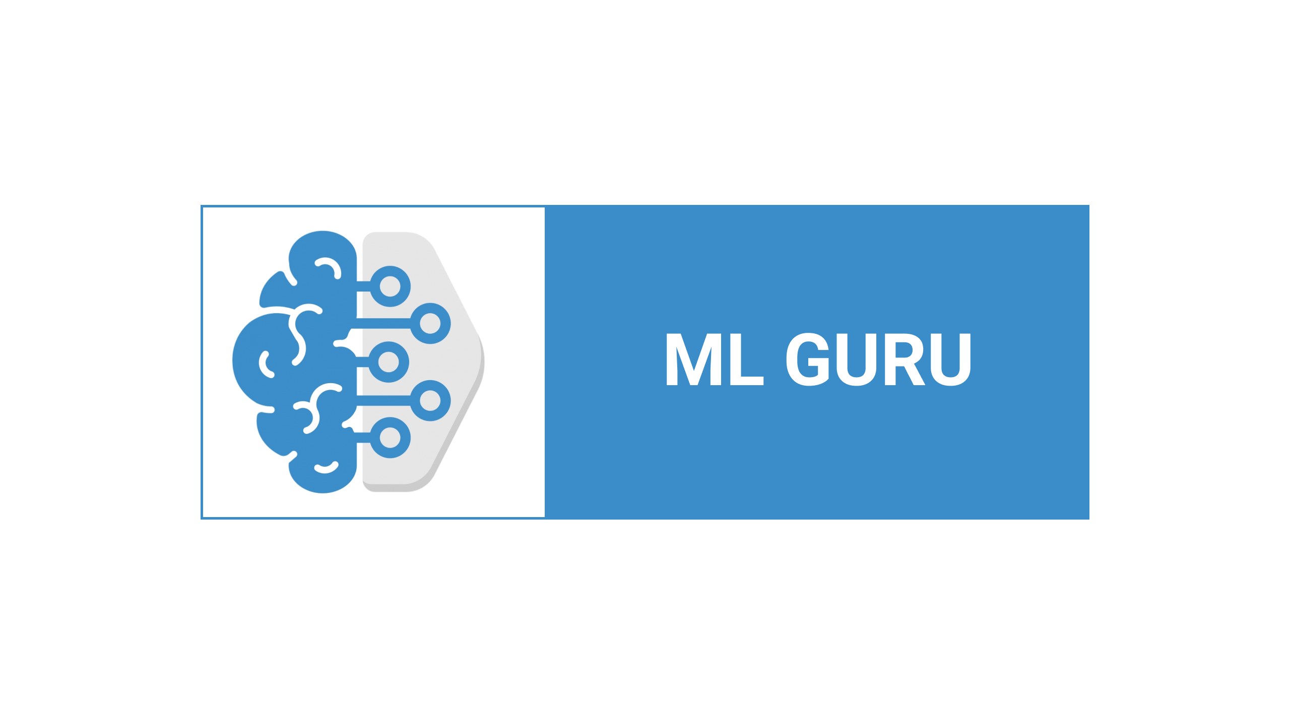

Slide 2
Lecture By Arjun Pukale

Slide 3

What Is Machine Learning?

Slide 4
What Is Machine Learning?
Machine learning was first defined in 1959 by Arthur Samuel, a pioneer in the field of artificial intelligence and machine learning. Samuel defined machine learning as a "Field of study that gives computers the ability to learn without being explicitly programmed".

Slide 5
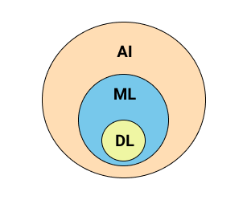
What Is Machine Learning?
Machine learning was first defined in 1959 by Arthur Samuel, a pioneer in the field of artificial intelligence and machine learning. Samuel defined machine learning as a "Field of study that gives computers the ability to learn without being explicitly programmed".

Slide 6
What Is Machine Learning?
Machine learning was first defined in 1959 by Arthur Samuel, a pioneer in the field of artificial intelligence and machine learning. Samuel defined machine learning as a "Field of study that gives computers the ability to learn without being explicitly programmed".
One of the standard definitions of machine learning, as given by Tom Mitchell – A computer program is said to learn from experience E with respect to some class of tasks T and performance measure P, if its performance at tasks in T, as measured by P, improves with experience E.

Slide 7
Difference Between Traditional Programming and Machine Learning

Slide 8
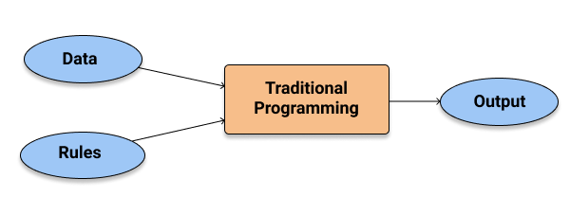
Difference Between Traditional Programming and Machine Learning

Slide 9
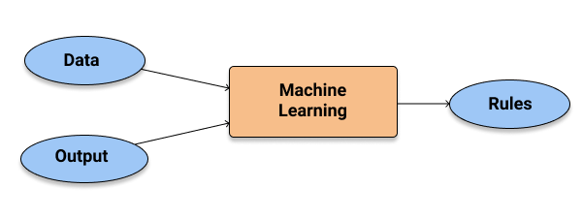
Difference Between Traditional Programming and Machine Learning

Slide 10
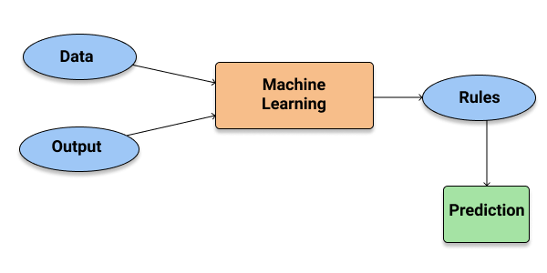
Difference Between Traditional Programming and Machine Learning

Slide 11
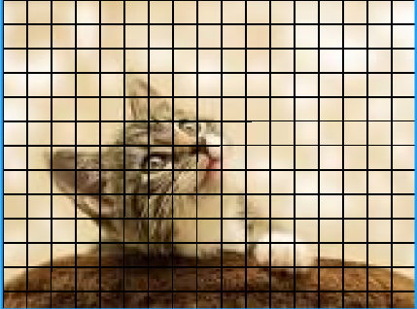
Why Machine Learning?
CAT OR NOT

Slide 12
Why Machine Learning?
CAT OR NOT
Traditional Programming:
If (condition 1):
{
…….
}
Else if(condition 2):
{
…….
}
Else:
{
…….
}
And so on….

Slide 13
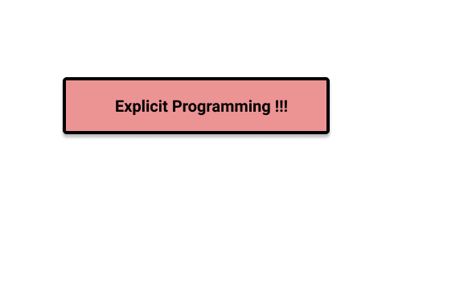
Why Machine Learning?
CAT OR NOT
Traditional Programming:
If (condition 1):
{
…….
}
Else if(condition 2):
{
…….
}
Else:
{
…….
}
And so on….

Slide 14
Why Machine Learning?
CAT OR NOT
Traditional Programming:
If (condition 1):
{
…….
}
Else if(condition 2):
{
…….
}
Else:
{
…….
}
And so on….
Machine Learning:
The Computer itself learns
The patterns !!!

Slide 15

Why Machine Learning?
CAT OR NOT
Traditional Programming:
If (condition 1):
{
…….
}
Else if(condition 2):
{
…….
}
Else:
{
…….
}
And so on….
Machine Learning:
The Computer itself learns
The patterns !!!

Slide 16
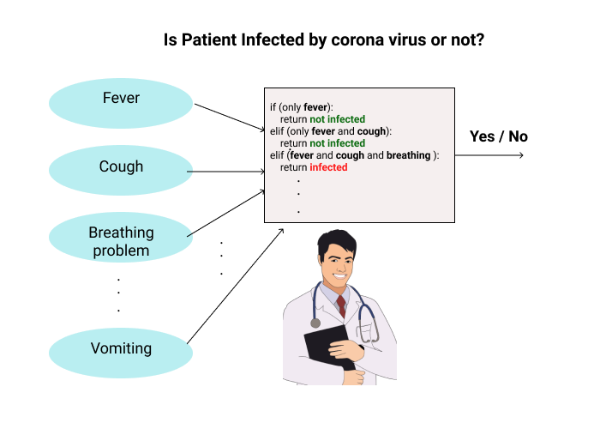
Another Example
TASK:
Traditional Programming!!!

Slide 17
Another Example
TASK:
LIMITATION!!!
But what if The decision making is based on much more complex symptoms(features)
Which is not known???
Traditional Programming!!!

Slide 18
Say Hii to Machine Learning !!!
Data :
Fever | Cough | Breathing Problem | ……………….. | Vomiting | Infected
1 | 0 | 0 | ……………….. | 0 | 0
1 | 0 | 1 | ……………….. | 0 | 1
0 | 1 | 0 | ……………….. | 1 | 0
1 | 1 | 0 | ……………….. | 1 | 1
1 | 0 | 1 | ……………….. | 1 | 1
………….. | ………… | …………. | …………. | …………… | ……

Slide 19
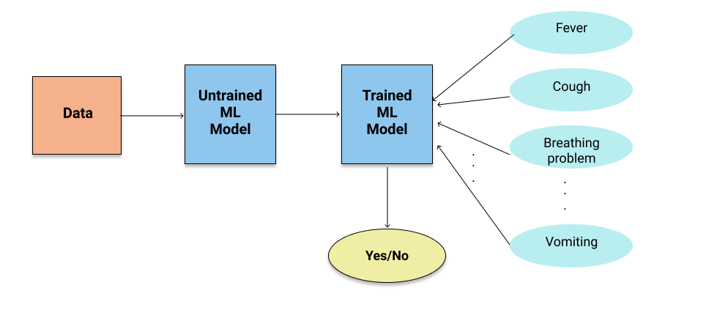
Say Hii to Machine Learning !!!

Slide 20
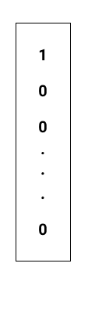
Say Hii to Machine Learning !!!
0

Slide 21

Say Hii to Machine Learning !!!
1

Slide 22
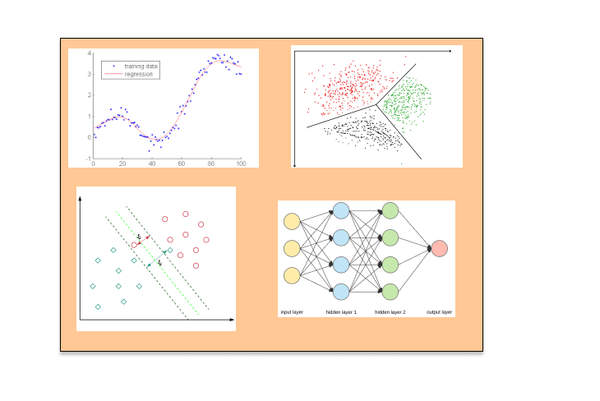


Why Machine Learning Is Successful Today?
Huge Amount of Data
Variety of models and easy to use
Fast and cheap computing devices

Slide 23
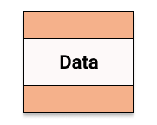
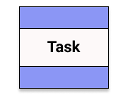
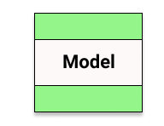
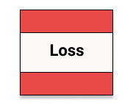
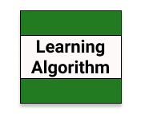
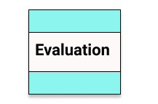
6 Elements Of Machine Learning

Slide 24



